Slide 1


Slide 2
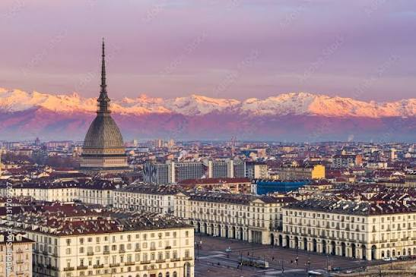
Torino: Royal elegance meets an industrial soul
As Italy’s first capital, the birthplace of the automotive industry, and a hub for cinema, Turin fascinates with its grand 19th-century boulevards, the majestic Mole Antonelliana, and the backdrop of the Alpine peaks. A forward-looking metropolis where Baroque art, technological innovation, and a world-class culinary tradition coexist in perfect harmony.

Slide 3
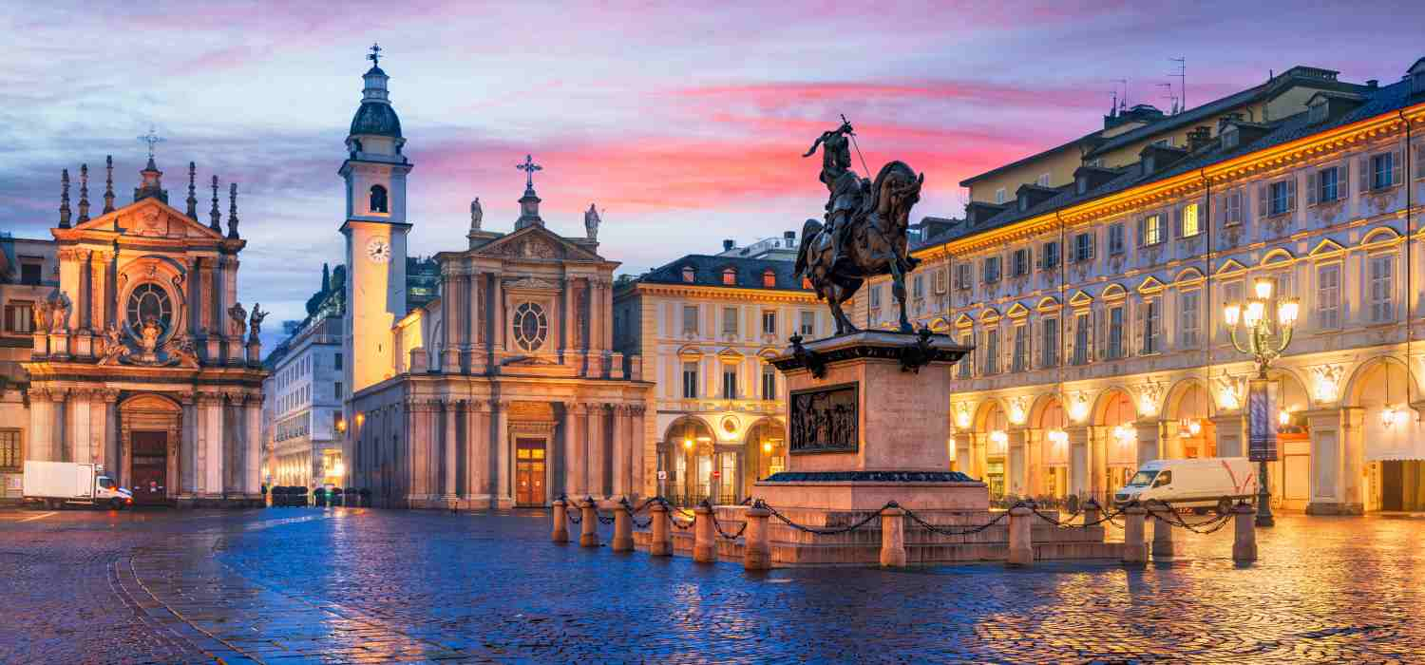
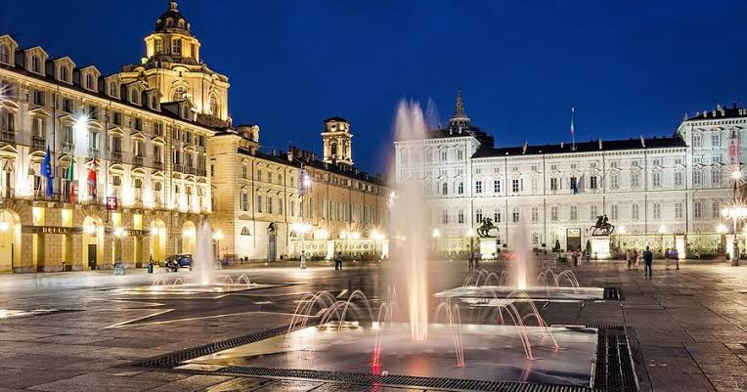
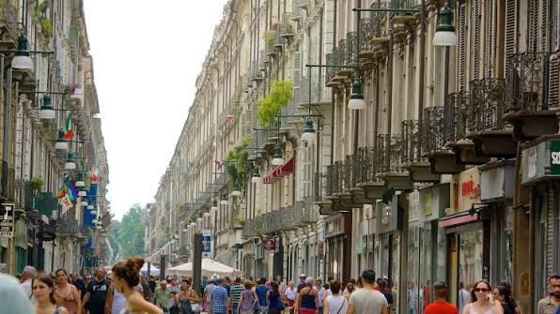
Discover Torino
https://www.turismotorino.org/en
www.visitpiemonte.com

Slide 4
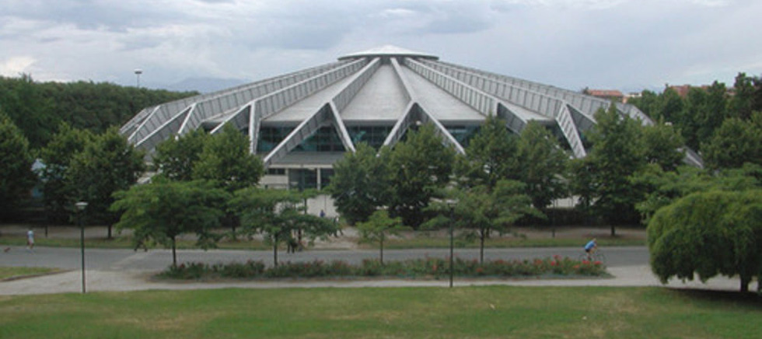
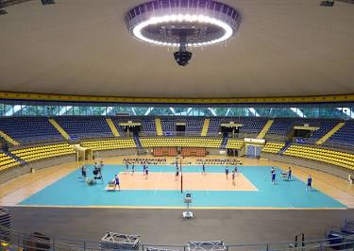
PALA GIANNI ASTI
The Main Hall
The Heart of Turin’s Sports Scene.
Historically known as PalaRuffini and nestled inside Ruffini Park, the PalaGianni Asti is Turin’s iconic indoor sports arena. Named after the legendary basketball coach Gianni Asti, this versatile ~4,500-seat venue serves as the city’s home for major basketball, volleyball, and gymnastics events, as well as live concerts and cultural shows.

Slide 5
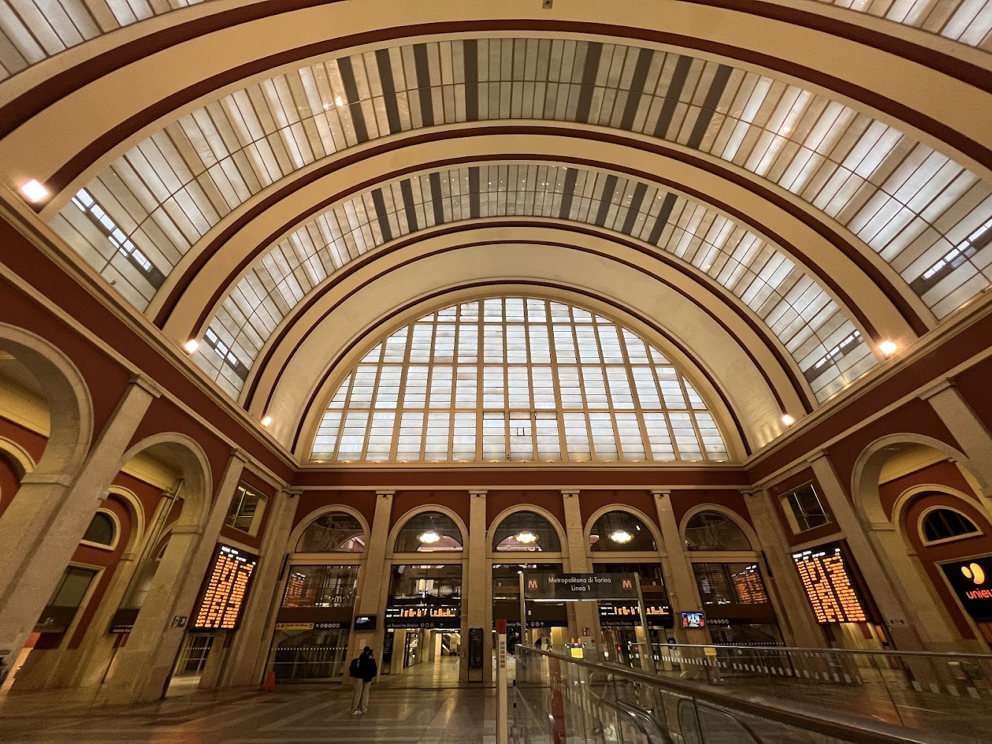
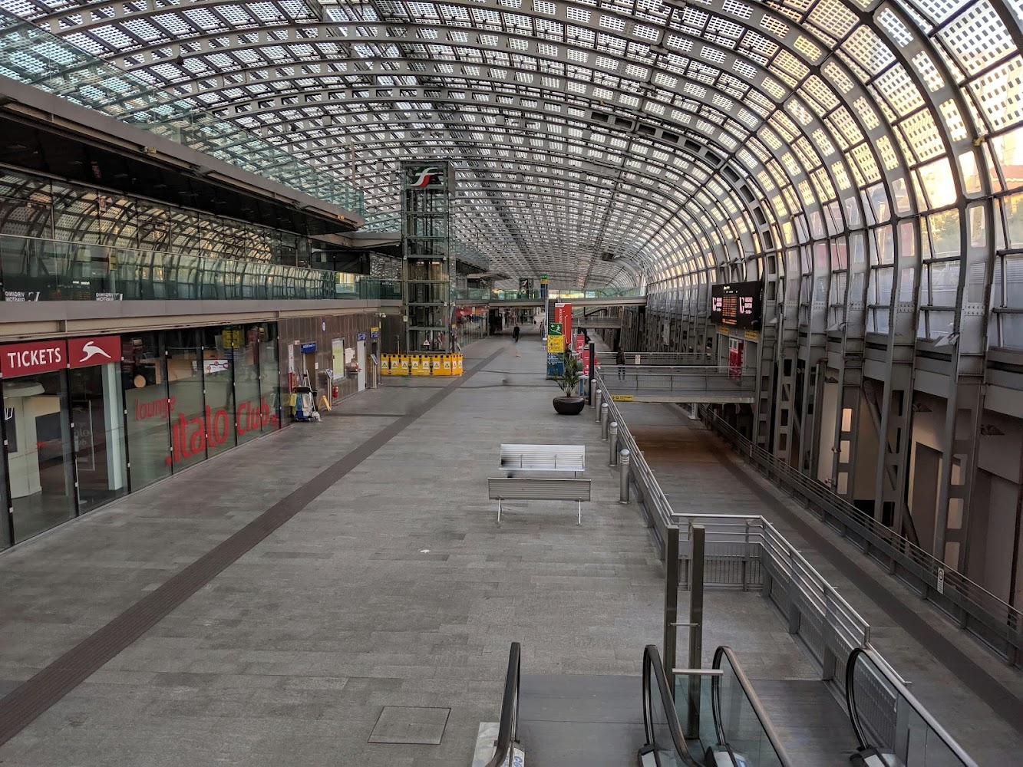
HOW TO REACH TORINO
Turin is a strategic travel hub for Northern Italy, easily accessible by train, plane, and road
PORTA NUOVA
The main central station, serving as the terminus for major routes to and from Milan, Rome, Naples, and Genoa .
By Train
Train travel is one of the most convenient and fastest ways to reach the city, thanks to high-speed rail lines (Frecciarossa and Italo) and international connections.
PORTA SUSA
A modern station and the city's second major railway hub, ideal for high-speed trains and direct international services with France (TGV) .

Slide 6
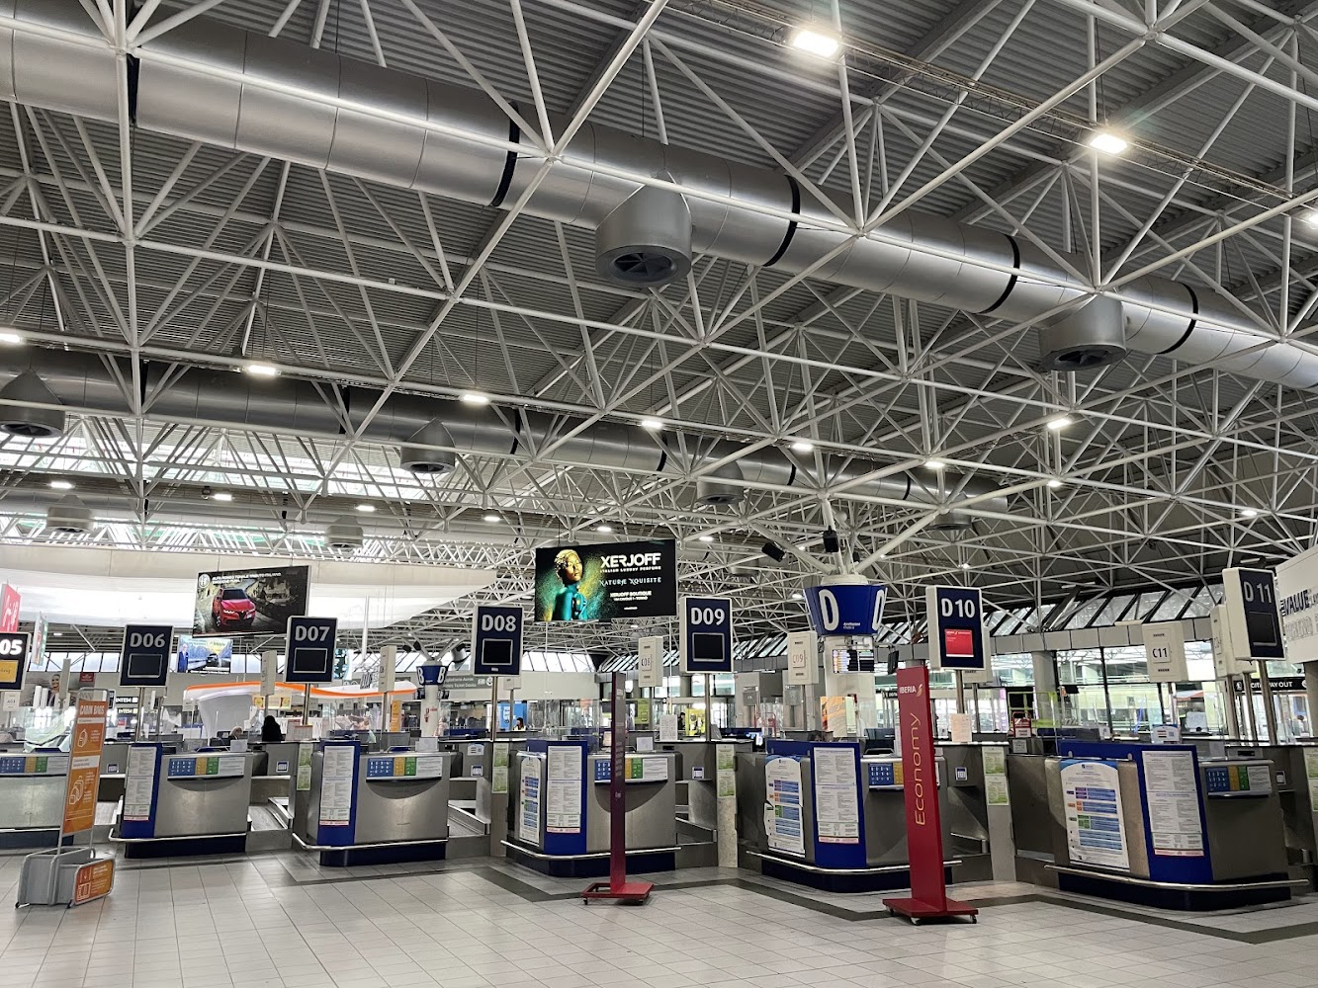
By Plane
Torino Airport Located approximately 16 km from the city center, it offers direct connections to downtown Turin via local train lines and shuttle buses (travel time is around 30 minutes).
Nearby Airports: Milan Malpensa is about 1.5 hours away with direct bus links to Turin. Milan Linate and Bergamo Orio al Serio serve as additional alternatives for international and low-cost flights.

Slide 7
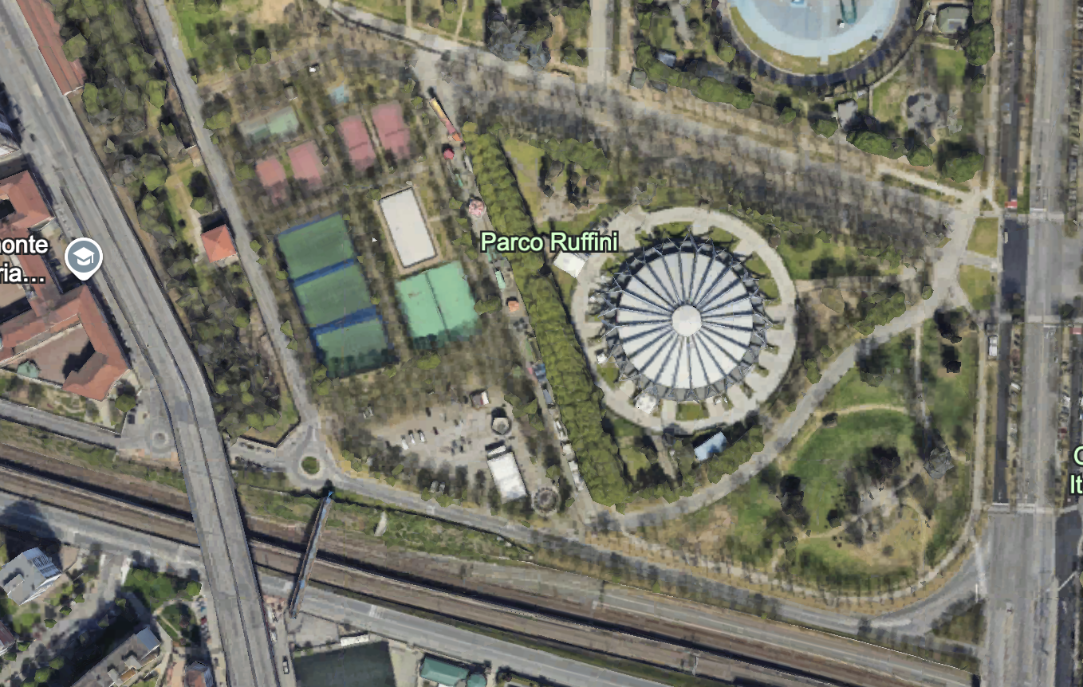
By Car and Road
Turin is a major highway junction connected directly via the city's ring road (A55):
A4 (Turin – Milan – Venice): Connects the city with Lombardy and Northeastern Italy.
A21 (Turin – Piacenza – Brescia): For routes originating from Southern and Central Italy.
A6 (Turin – Savona): Connects to Liguria and the Tyrrhenian coast.
A5 (Turin – Aosta): Leads toward the Aosta Valley and mountain passes into Switzerland and France (via the Mont Blanc Tunnel).
A32 (Turin – Bardonecchia): Route toward France via the Frejus Road Tunnel.

Slide 8
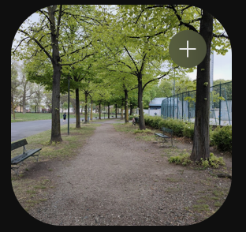
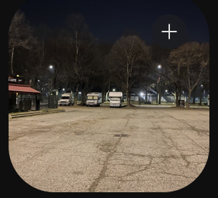
Where to park at the Arena
For tourist bus and coach parking near PalaGianni Asti options depend on whether you need a quick drop-off/pick-up or long-term parking during an event:
Short-Term Drop-Off and Pick-Up:
Drivers typically pull over along the service lanes of Corso Trapani or Corso Rosselli adjacent to Parco Ruffini to let passengers off close to the arena entrances.
Long-Term Bus Parking:
  If the bus needs to stay parked for the entire duration of an event, driver parking is available in designated tourist bus parking zones across the city, as residential park perimeters do not feature permanent coach parking bays.

Slide 9
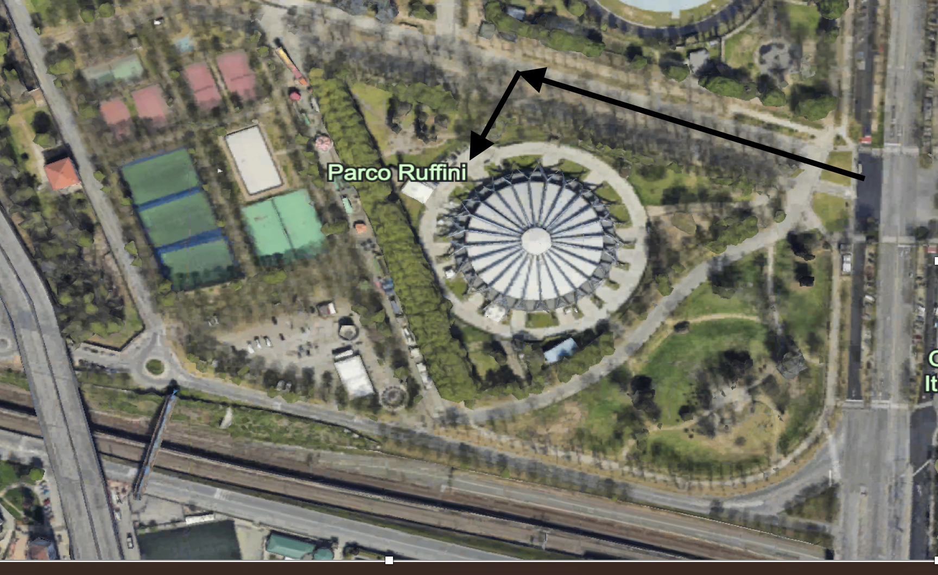
Where to go to unload the Props
ACCESS FROM C:SO TRAPANI AND FOLLOW THE ARROWS
To authorize your entry into the pedestrian zone, we need to know:
- Vehicle license plate number
- Date and time of unloading
- Date and time of loading
- Name of the people coming

Slide 10
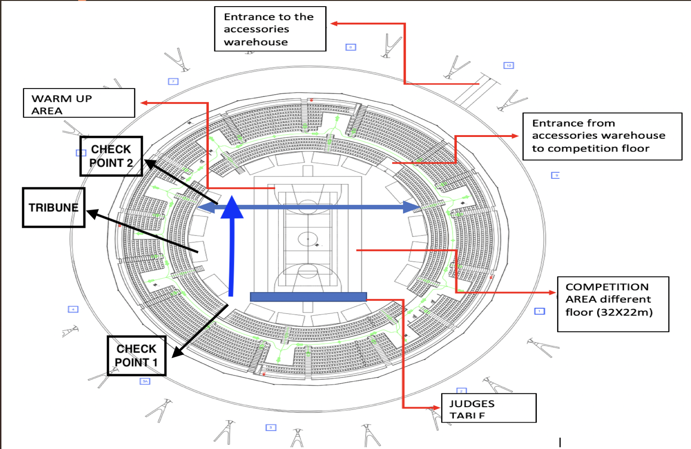
ARENA SETTING

Slide 11
Only a few specific, essential items—such as costumes—may be left in the changing rooms; if everyone leaves their bags and jackets there, there won't be enough space for everyone.
What to do when you arrive at the Arena
Go to the stands reserved for each nation
Go and sit in the reserved area
LEAVE ALL YOUR STUFF IN THE STANDS
Entry from Athletes door

Slide 12
WHAT TO DO BEFORE COMPETITION
GO TO YOUR CHANGING ROOM ONLY TO CHANGE DRESS
GO TO SMALL GYM FOR WARM UP
GO TO CHECK POINT 1

Slide 13
PATHWAY TO ENTER THE COMPETITION
CHANGING ROOM
CHECK POINT 1 (4 SETS BEFORE for SOLO and PAIRS, 2 SET BEFORE for TEAMS & GROUPS)
WARM UP AREA
CHECK POINT 2 (1 SET BEFORE COMPETITION)
COMPETITION FLOOR

Slide 14
OPENING CEREMONY
1
ARRIVE AT THE ARENA AT 8.00 am
2
GO TO RESERVED SEATS AND LEAVE YOUR STUFF THERE
3
GO TO YOUR COUNTRY PLACE READY TO GO

Slide 15
IMPORTANT NOTICES
BATON
NO BATON ALLOWED DURINGTHE CEREMONY
DRESS
Official National Team Tracksuit
WHAT I CAN BRING WITH ME
SMALL FLAG OF THE COUNTRY
MOBILE PHONE

Slide 16
CLOSING CEREMONY
SAME AS OPENING CEREMONY
It will take place on Sunday, following the awards ceremony

Slide 17
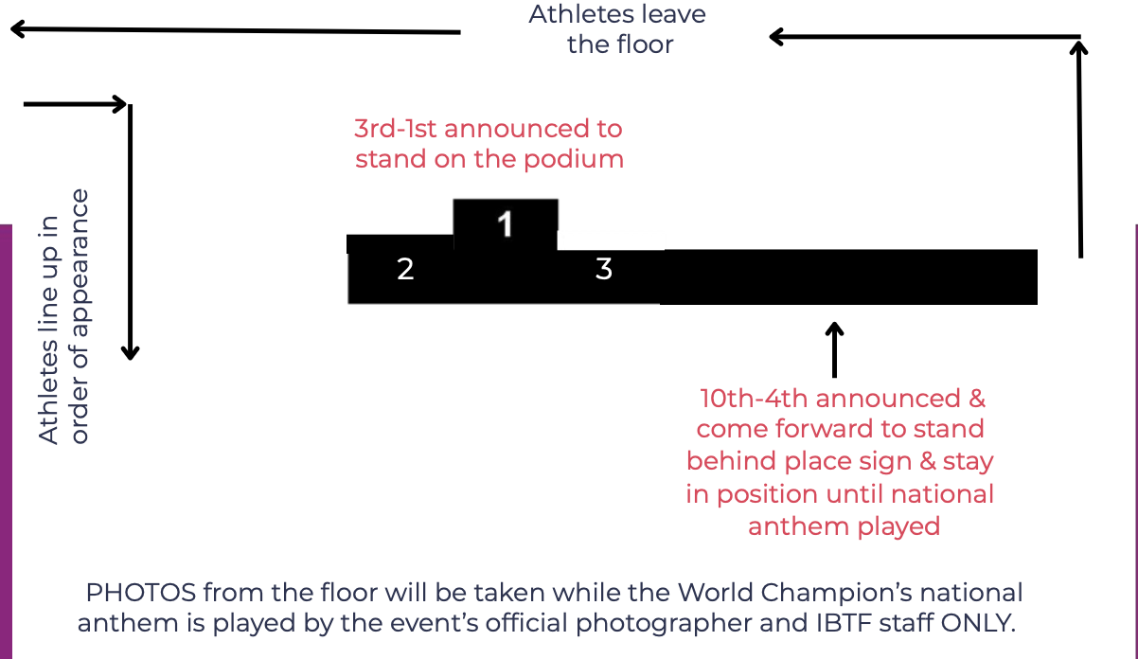
AWARDS CEREMONY
SATURDAY & SUNDAY AY THE END OF COMPETITION
TAKE PLACE BEHIND THE CURTAIN WAITING FOR YOUR CATEGORY
DRESS: NATIONAL TRACK SUIT

Slide 18
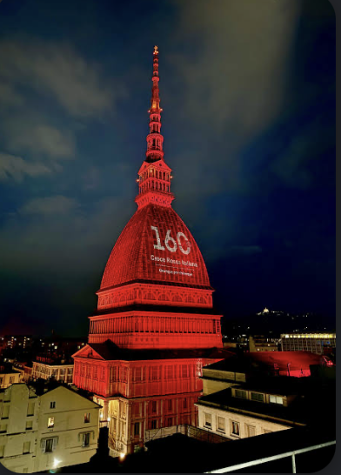
SPECIAL EVENT 28th OCT: ILLUMINATION OF THE MOLE ANTONELLIANA
8.00 PM: THE MOLE ANTONELLIANA LIGHTS UP WITH THE EUROPEAN CHAMPIONSHIP LOGO. A TRIBUTE FROM THE CITY TO ALL THE MAJORETTES COMPETING IN THE EUROPEAN CHAMPIONSHIP. EVERYONE OUT FOR A MASSIVE FLASH MOB.
BRING YOUR BATONS AND WEAR SPARKLY OUTFITS!
Meeting at 7:45 PM at Via Montebello 20, 10124 Turin (TO)
Follow IBTF and FITW on social media to learn the routine.

Slide 19
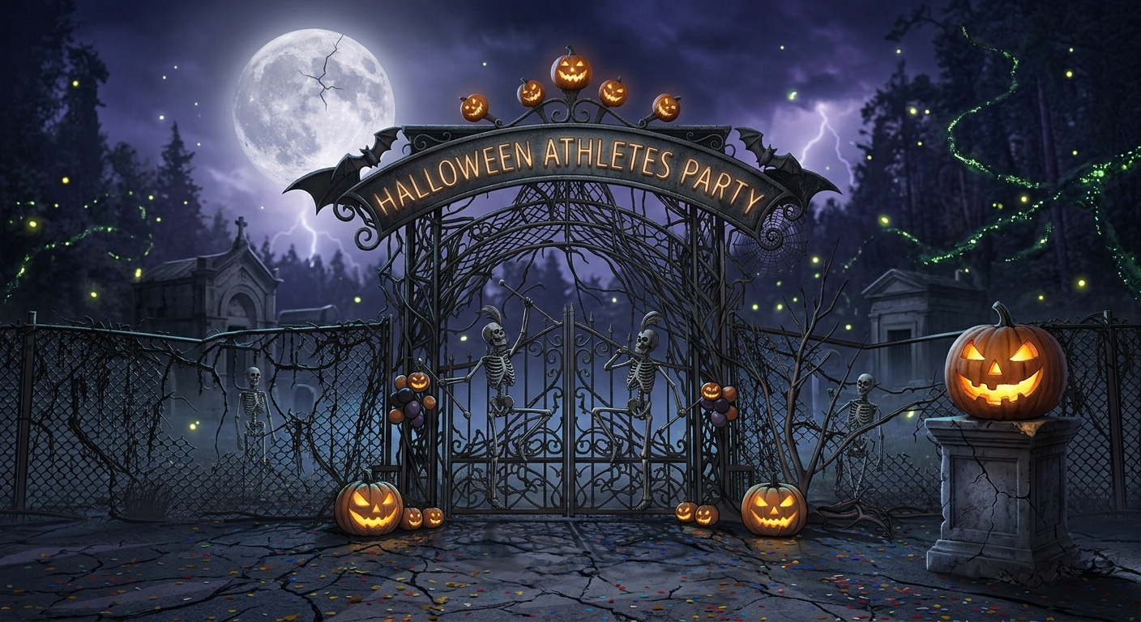
ATHLETES PARTY…
HALLOWEEN IS COMING…

Slide 20
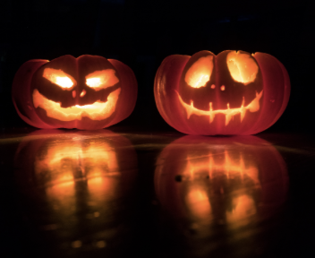
ATHLETES PARTY
INFORMATIONS
WHERE: MAIN ARENA
WHEN: Saturday 31 st Oct 8PM (after awards Ceremony)
DRESS CODE: HALLOWEEN STYLE
DANCE – DRINKS – SNACKS for ATHLETES & COACHES

Slide 21
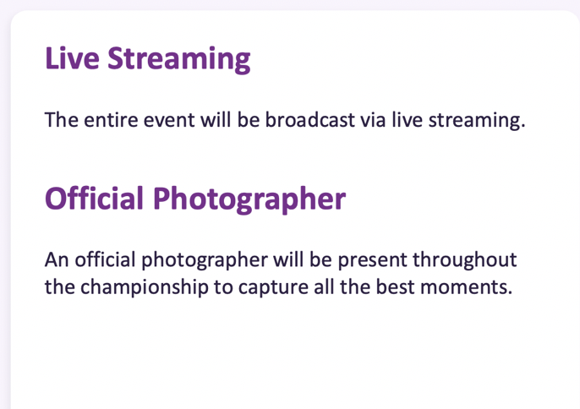



OTHER INFORMATIONS

Slide 22
FOOD & BEVERAGE
ATHLETES & COACHES
Bringing your Food & Drink is not allowed (Except water bottles and bars)
SPECTATORS
Bringing your own food is not allowed
There is a BAR inside the Arena
We are sending info about Restaurants around the Arena in few days
Pre ordered lunch will be available in the designated restaurant area
A medical note is required for exceptions.

Slide 23
LUNCH FOR ATHLETES
LUNCH WILL BE SERVED EVERY DAY FROM 11.30 AM TO 2.30 PM
MENU INCLUDES 1STARTER OR CHEESE + 1 MAIN COURSE + 1 DESSERT + 1 BOTTLE OF WATER
FILL THE FORM AND SEND BY MAIL TO magassabahyon@gmail.com OR BY WHATSAPP TO
+39 3509377543 BEFORE 17 TH OF OCTOBER
PAY THE INVOICE BEFORE 28 TH OF OCTOBER
TAKE YOUR VOUCHERS DURING THE REGISTRATION

Slide 24

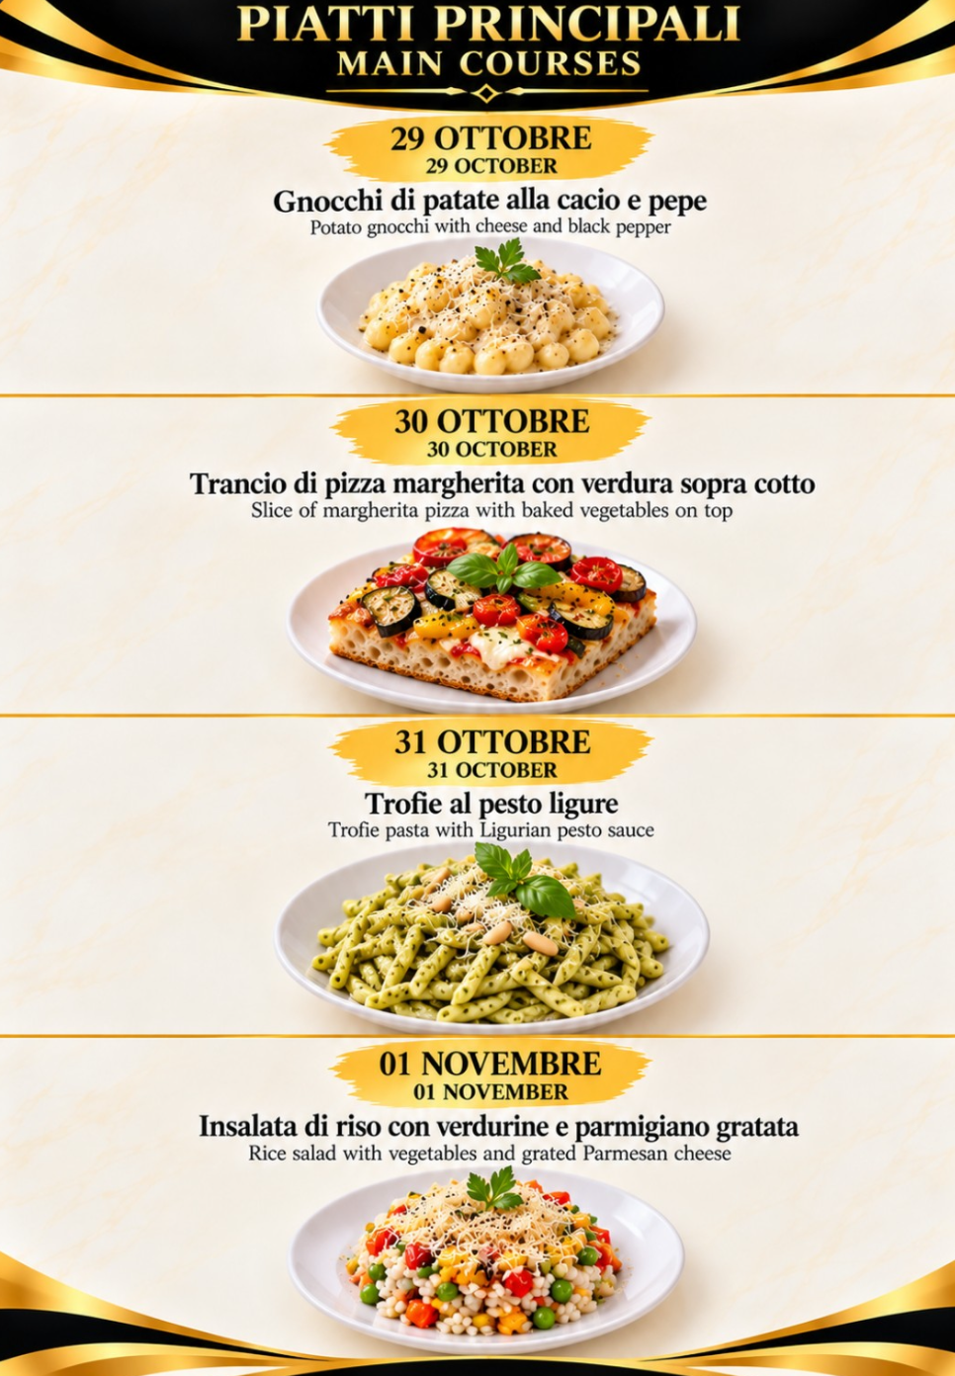
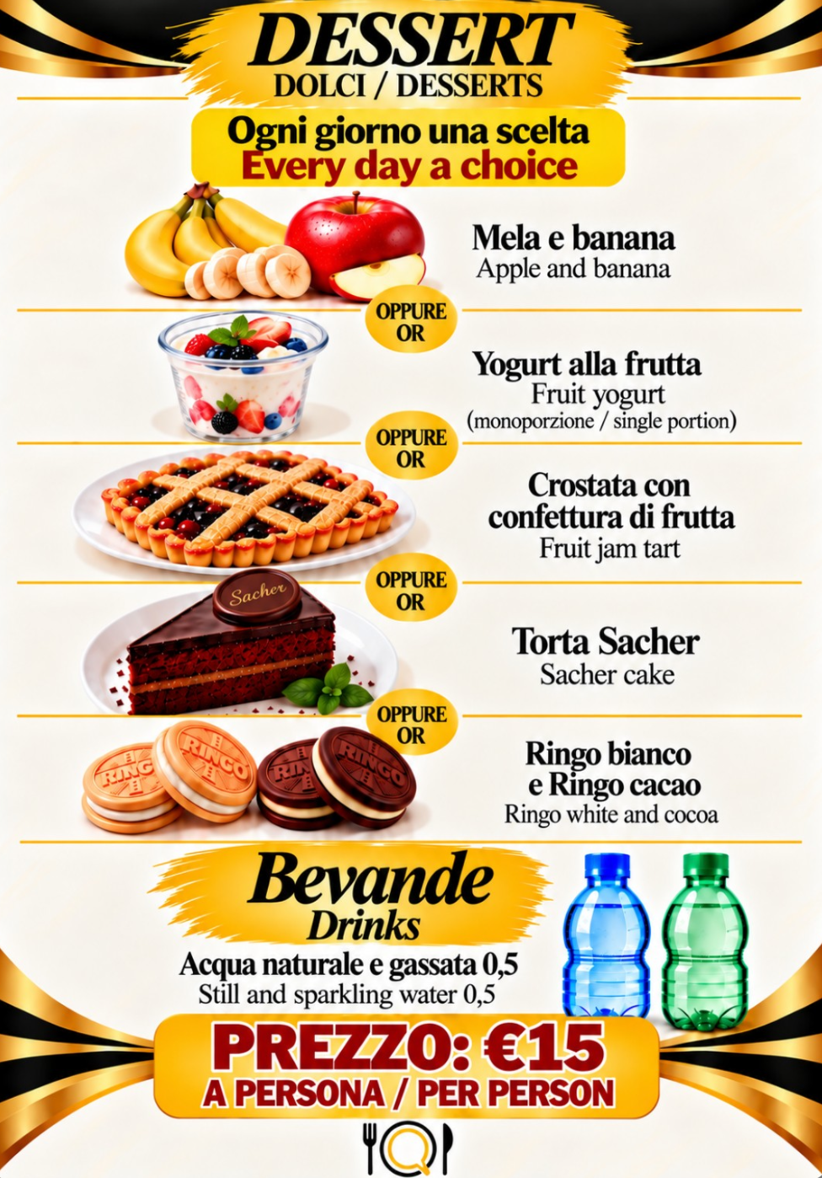

Slide 25
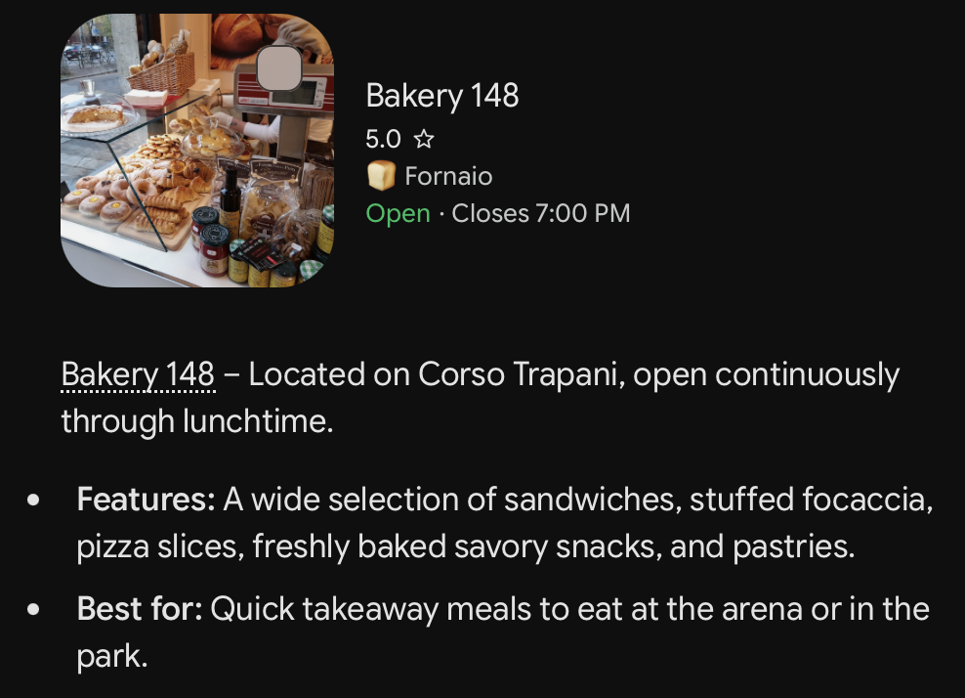
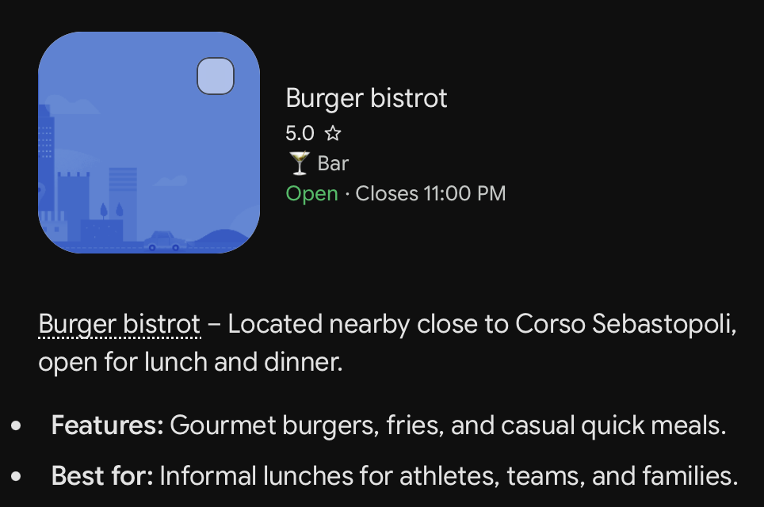
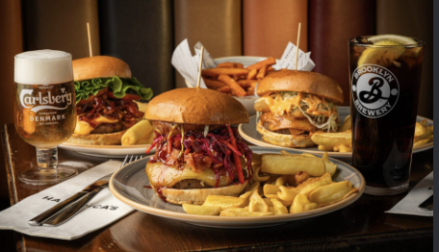
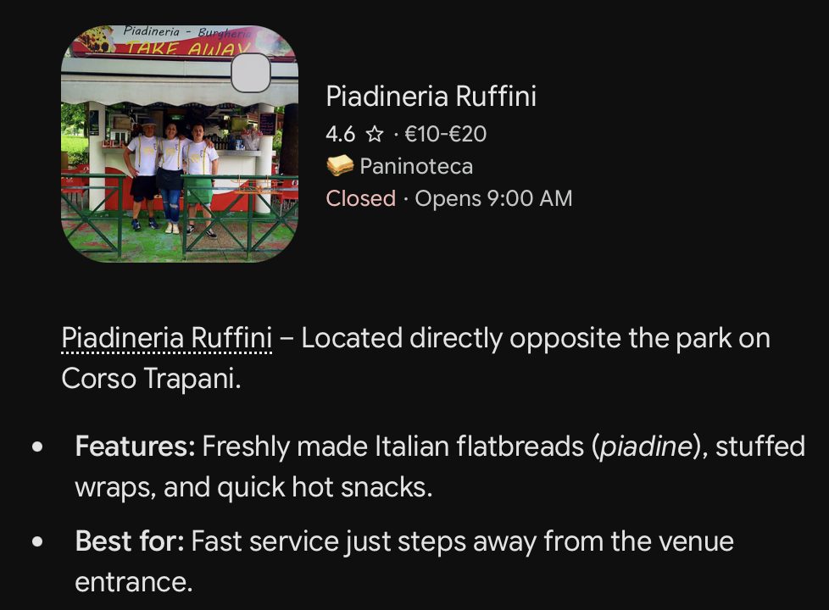
Food & Dining Near the Venue (Open for Lunch)
Sandwiches, Bakeries & Quick Bites

Slide 26
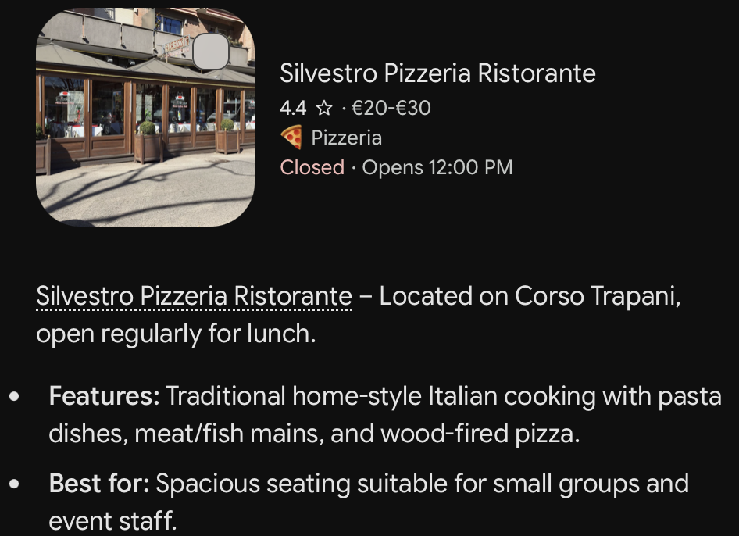
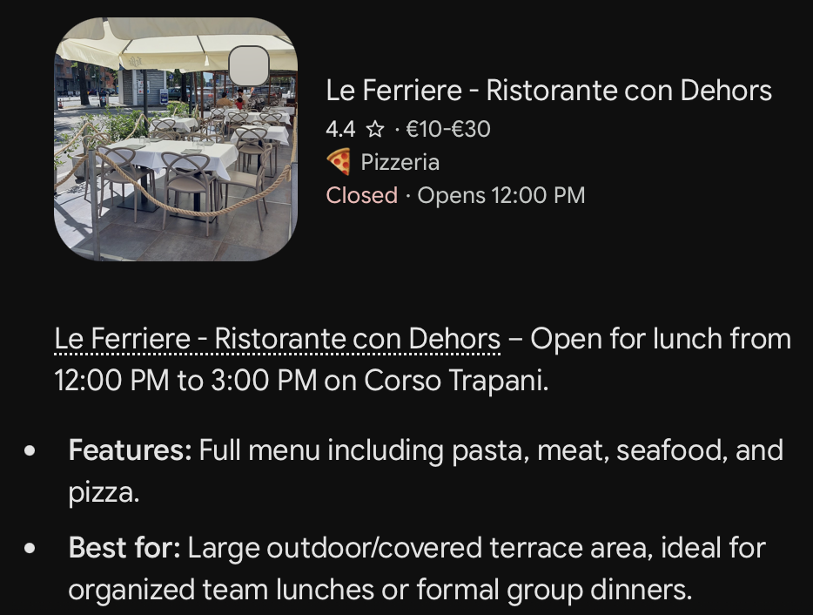
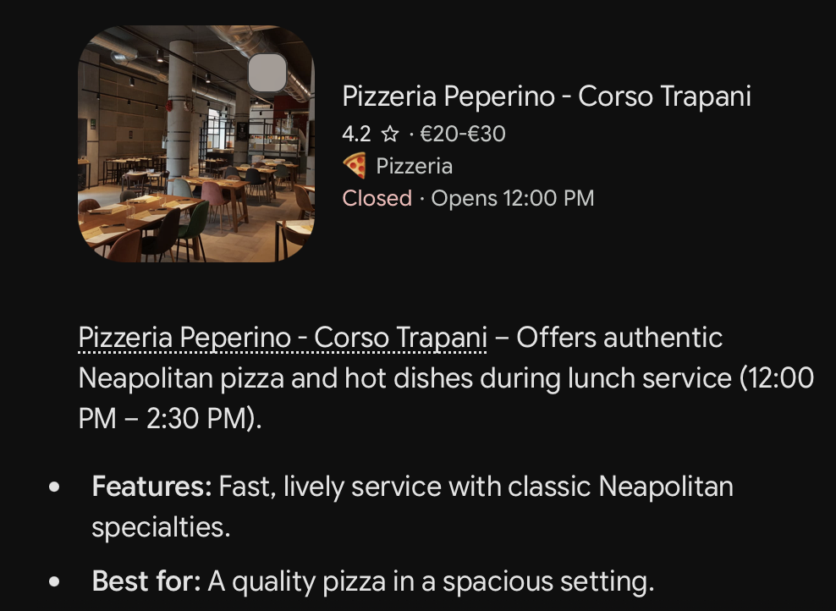
Restaurants & Pizzerias (Open for Sit-Down Lunch)

Slide 27

ANY QUESTION?

